Slide 1
PART 1
RELATIONAL DATABASES

Slide 2
Chapter 2 Introduction to the Relational Model

Slide 3

Introduction to Chapter 2
Relational data model
relational data structure ( syntax)
integrity constraints (semantic)
constraints on attributes of schemas, e.g. value domain, type
constraints on dependencies among attributes of a schema
constraints on dependencies among attributes of different schemas
relational normal forms (范式，chapter 7)
operations on the model
Notes:
数据模型是数据库结构的基础。任何数据库都是基于一定的数据模型进行组织数据的。本章重点讲述关系模型，包括三要素：
关系数据结构；完整性约束；数据操作。
本章围绕如上三个要素展开来讲。

Slide 4

Main Parts in Chapter 2
Relational data structure (syntax ,§2.1-2.4)
basic elements in relational data model, i.e. tables and attributes, and relationships among them
Integrity constraints (semantic, 未涉及)
constraints on keys in relational schema
Relational Operations
—Relational algebra (关系代数,§2.5, 2.6)

Slide 5



§2.1 Structure of Relational Databases
A relational database consists of a collection of relational tables
e.g. instructor , course, prereq, department, sections, teaches
a row in a table represents a relationship among a set of values
a table is such a collection of relationships.
2.1.1 Basic structure
Given sets D₁, D₂, …. D_{n} , a relation r is a subset of D₁ ╳ D₂ ╳ … ╳ D_{n}
r = {(a₁, a₂, …, a_{n} )} ⊆ D₁ ╳ D₂ …..╳ D_{n}
relation r = { tuple } /*元组
定义：关系定义为一系列域上的笛卡尔积的子集
Notes:
关系r中每个元素是一个n元组，每个元素构成关系的一个元组。
域：是属性的取值范围，如整数域，实数域等。属性的数据类型，可运行的取值的集合。
关系是笛卡尔积的扩展，给每个域分别起个名字，称为属性名。
举个笛卡尔积的实例：
D1（姓名）={张，李，王}，D2（年龄）={20,30}
D₁ ╳ D₂ ={（张，20），（张，30），（李，20），（李，30），（王，20），（王，30）}
笛卡尔积：是各个域上取值的所有排列组合。
关系：是笛卡尔积的有限子集，是有意义的，每个域有个属性名。

Slide 6














2.1.1 Basic Structure (cont.)
Attributes of relation r
A₁, A₂, …, A_{n}
domain of the relation’s attributes D₁, D₂, …. D_{n}
the set of allowed values for each attribute
Notes
relation r in DBS is the limited set (有限集合)
attributes in tuples are non-ordered (无序性)
e.g. (d₁, d₂, …, d_{n}) = (d₂, d₁, …, d_{n})
the order in which the tuples appear in a relations is irrelevant
Fig.2.1 vs. Fig.2.4
several attributes may have the same domain
Notes:
属性的顺序，元组的顺序对于关系表的结构来说，没有影响，是等价的。

Slide 7
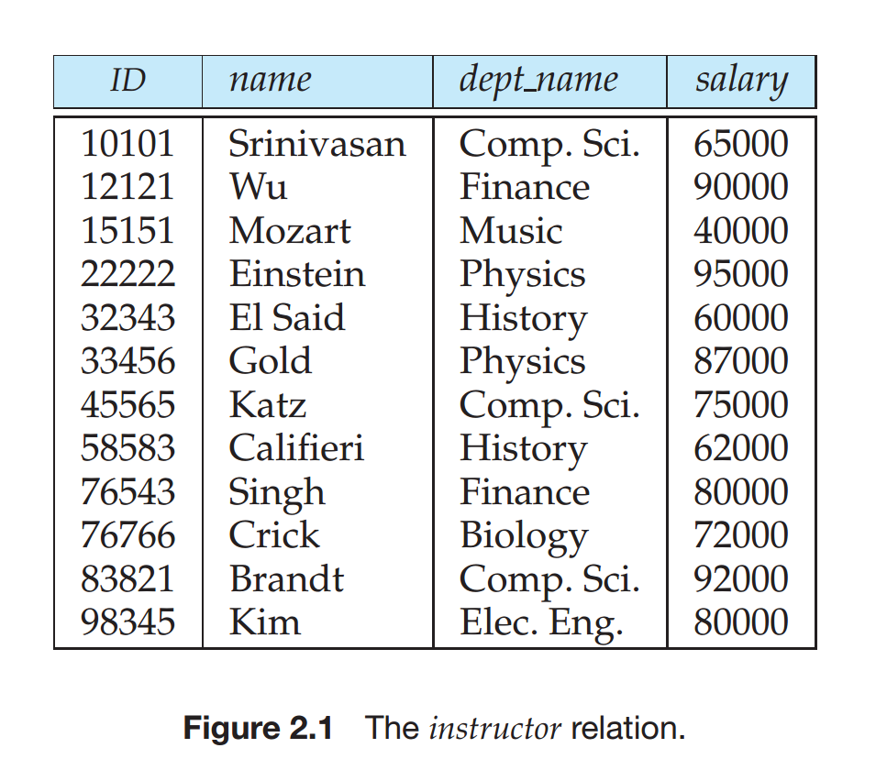
2.1.1 Basic Structure (cont.)
Notes:
属性的顺序，元组的顺序对于关系表的结构来说，没有影响，是等价的。

Slide 8
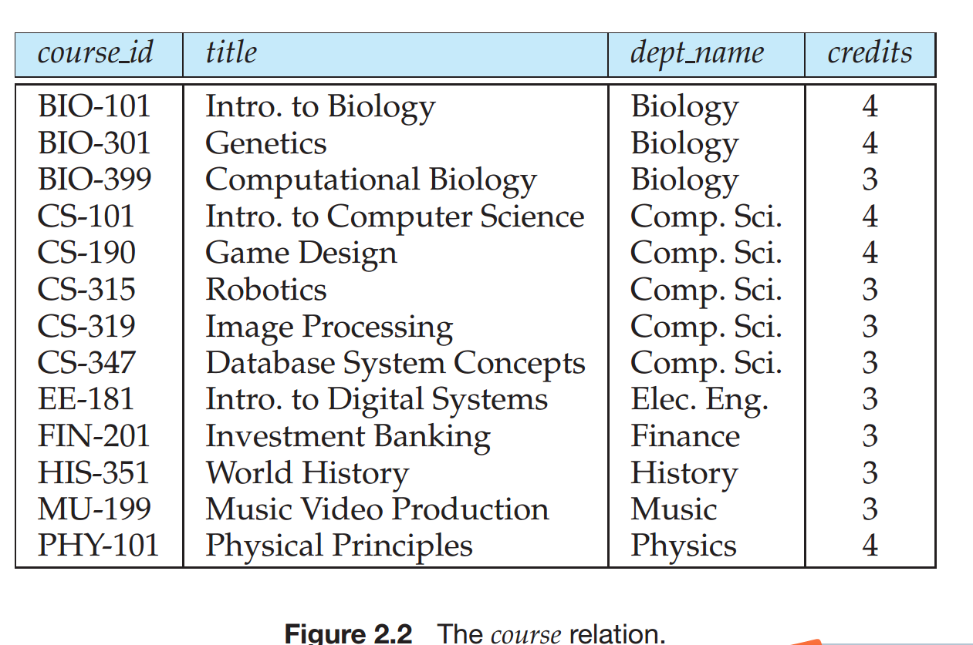
2.1.1 Basic Structure (cont.)
Notes:
属性的顺序，元组的顺序对于关系表的结构来说，没有影响，是等价的。

Slide 9
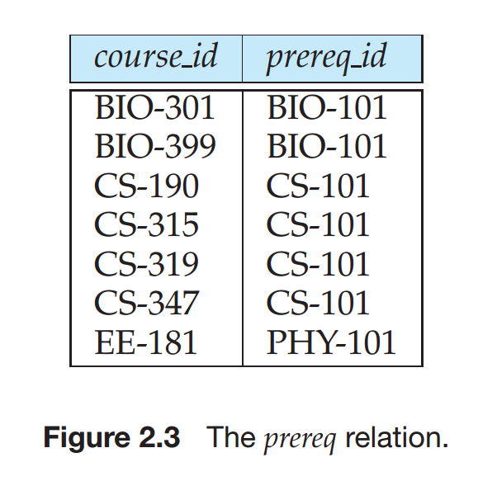
2.1.1 Basic Structure (cont.)
Notes:
属性的顺序，元组的顺序对于关系表的结构来说，没有影响，是等价的。

Slide 10
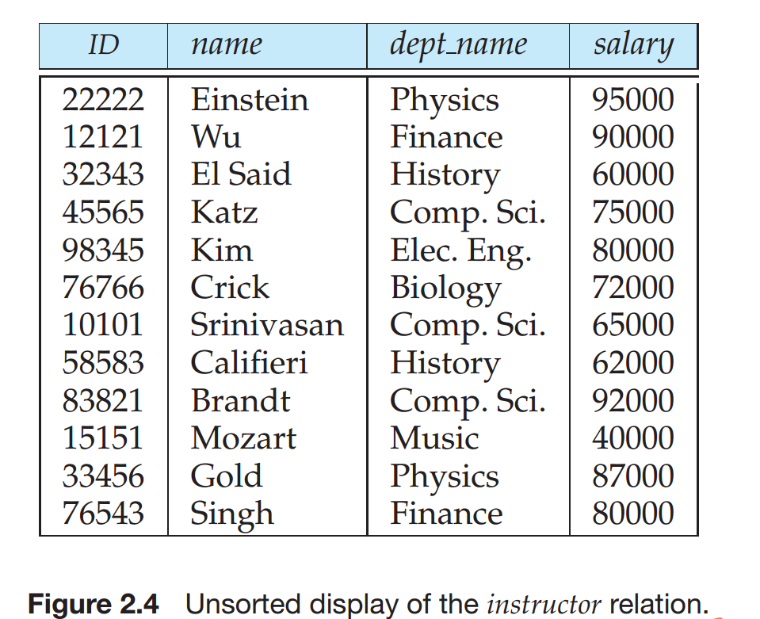
2.1.1 Basic Structure (cont.)
Notes:
属性的顺序，元组的顺序对于关系表的结构来说，没有影响，是等价的。

Slide 11



2.1.1 Basic Structure (cont.)
the special value null is a member of every domain.
the null value causes complications in the definition of many operations
Example
student_name = {Jones, Smith, Curry, Lindsay} depart= {CS, EE, Physics} student_city = {Harrison, Rye, Pittsfield}
then r = { (Jones, CS, Harrison), (Smith, Physics, Rye), (Curry, EE, Rye), (Lindsay, CS, Pittsfield)} is a relation over student_name ╳ depart ╳ student_city
Notes:
举例说明：关系是定义在域上的笛卡尔积的有限子集。

Slide 12








2.1.1 Basic Structure (cont.)
A domain is atomic if its elements are considered to be indivisible
all domains of R should be atomic, first formal norm
anti-e.g. multivalued attribute values are not atomic, { {1, 2}, {4}, {4, 6, 7} }
anti-e.g. composite（复合的）attribute address={city, street, zipcode} is not atomic
Notes:
如成绩属性，在关系表中，不能进一步分为C成绩，Java成绩等，但是这些不同课程的成绩可以单独成列。

Slide 13

2.2 Database schema
For attributes A₁, A₂, …, A_{n} , R = (A₁, A₂, …, A_{n} ) is a relation schema
e.g. in Fig. 2.1, Instructor-schema = (ID, name, depart_name, salary)
orders of attributes is irrelevant
r(R) is a relation on the relation schema R
e.g. customer (customer-name, customer-street, customer-city) on Customer-schema
Relation instance
the current values of a relation r at a particular time
specified by a table

Slide 14

§2.1.2 Relational schema (cont.)
the term relation and relation instance are used interchangeably in the textbook
Tabular（表格的） representation of r(R)
the current values of a relation r(R) (i,.e., relation instance of the relation r) are specified by a table
an element t in set r is a tuple, represented by a row in a table
tuple variable t, t[A_{i}] = the value of t on the attribute A_{i} , or t[{ A_{i} }] = the value set of t on the attribute set {A_{i} }
e.g. in Fig.2.1, t2[name]= Wu
orders of tuples is irrelevant, i.e. tuples may be stored in an arbitrary order

Slide 15
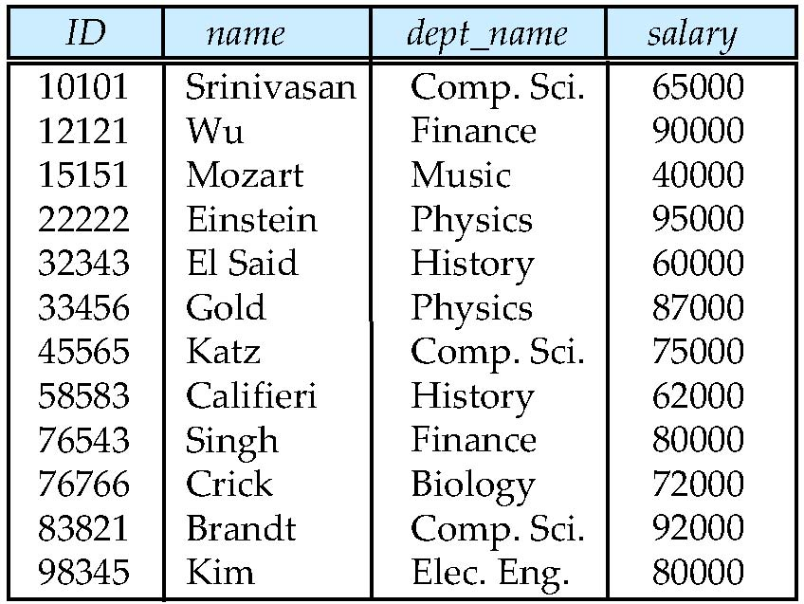
Fig. 2.1 The instructor relation
attributes
(or columns)
tuples
(or rows)

Slide 16
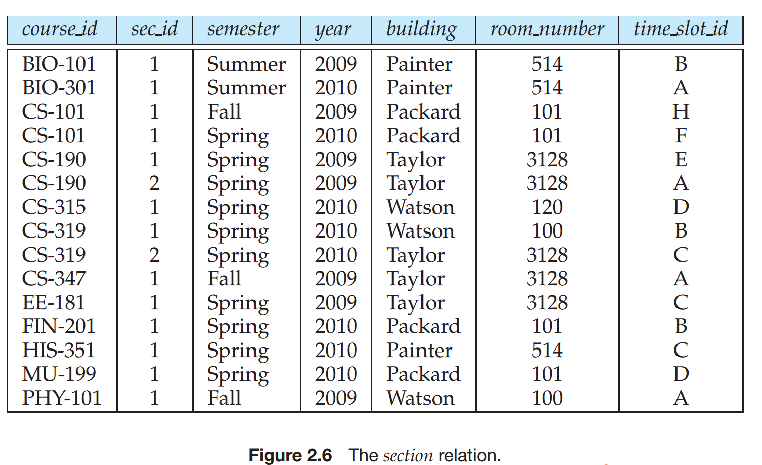
课题练习：
1. 写出Fig 2.6，Fig 2.7 的schema

Slide 17
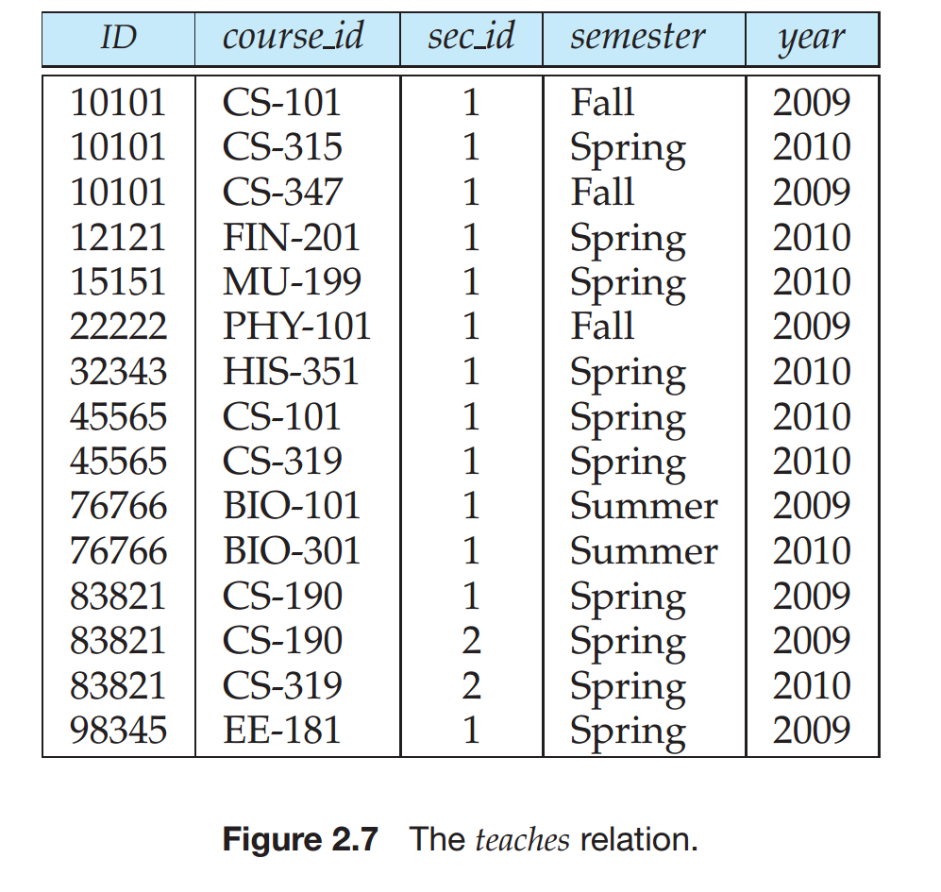

Slide 18
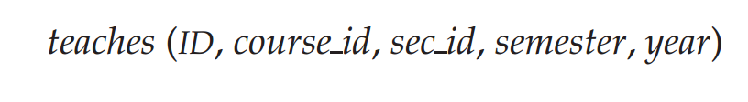
Fig. 2.1 The instructor relation
Fig 2.6，Fig 2.7 的schema

Slide 19
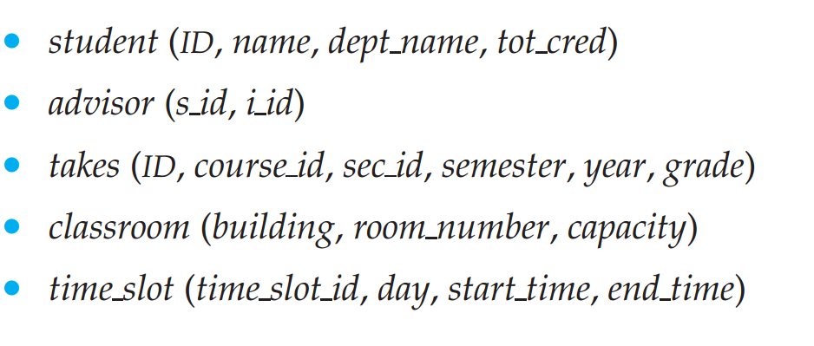
Fig. 2.1 The instructor relation
2. 给出以下关系模式， 请大家分别画出对应的表

Slide 20




2.3 Keys
Key : 键，码
A superkey is a set of one or more attributes that, taken collectively, can be used to identify uniquely a tuple in the relation
Def. Given relation schema R(A₁, A₂, …, A_{n}), a subset K of R is the super key of R , if no two distinct tuples in relation r(R) have the same values on all attributes in K
that is, if t₁and t₂ are in r and t₁≠t₂, then t₁[K]≠t₂[K]
the super key may contain redundant attributes
e.g. {ID} vs {ID, name, dept_name}
K is a candidate key if K is minimal super key
候选码：是最小的超码
e.g.{ID} is a candidate key for instructor, assuming no two instructors can possibly have the same identifiers

Slide 21
Keys (cont.)
A relation may have several candidate keys. Primary key is a candidate key chosen by the database designer as principal（主要的） means to identify tuples within a relation
Def. Primary attributes(主属性!）
taking the key as a attribute set, the attributes in the candidate keys, i.e. the element of the primary key is called the primary attributes
non-primary attributes(非主属性）

Slide 22
Keys (cont.)
Def. If X is one or more attributes in relation r₁, and X is also the primary-key of another relation schema r₂
taking Fig.2.8 as case studies
X is called a foreign key from r₁ referencing r₂
X是由r₁参照/关联r₂的外键
r₁ is called the referencing relation of the foreign key dependency
外键的参照/关联关系
r₂ is called the referenced relation of the foreign key
外键的被参照/关联关系
e.g. dept_name in instructor-schema (Fig.2.8) and department-schema, dept_name in instructor is a foreign key from instructor referencing department

Slide 23


Keys (cont.)
A database schema, along with primary key and foreign key dependency, can be depicted as the schema diagram（模式图）
e.g. Fig.2.8
node
schema, attributes, primary key
directed arc（有向弧）
foreign key dependency, from referencing relation r₁ to referenced relation r₂

Slide 24
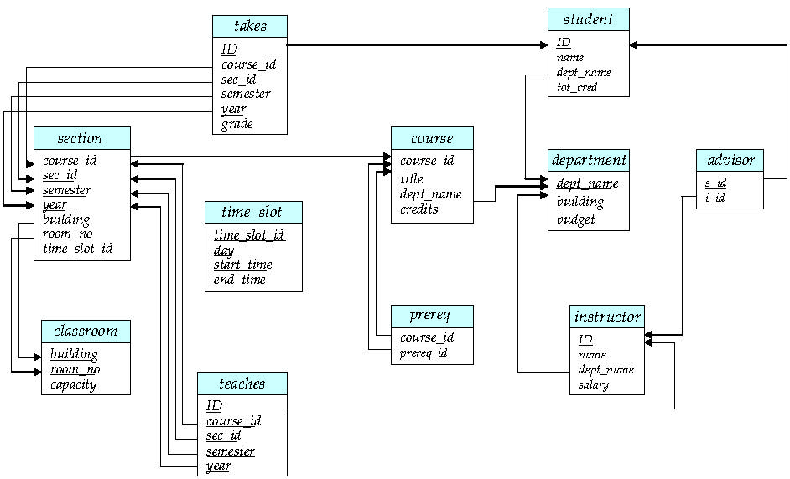
r2
r1
Fig. 2.8 Schema Diagram

Slide 25
Keys
Foreign key/Referential integrity constraint
values appearing in specified attributes (e.g. dept_name)of any tuples in the referencing relation (e.g. instructor) must appear in specified attributes of at least one tuples in the referenced relation(e.g. department)
– dept_name in instructor is a foreign key from instructor referencing department
why?
— the department that an instructor belongs to in the relation instructor （e.g. Com.Sci）must be a department that has been defined in the relation department，i.e. Com.Sci corresponds to a tuple in department

Slide 26
注意事项
数据库导入数据时，先导入被参照关系r₂中的数据，后导入参照关系r₁中的数据

Slide 27

2.5 Query language
Query Language
the language in which user requests information from the database
Categories of languages
Procedural（过程化的）：用户指导系统对数据库执行一系列操作以计算所需结果
Non-procedural（非过程化的）, or declarative(声明的)：用户只需描述所需信息，而不用给出获取该信息的具体过程。(SQL)
“Pure” languages
relational algebra（关系代数）
tuple relational calculus（元组关系演算）
domain relational calculus（域关系演算）
Pure languages form the underlying basis of query languages in practical uses

Slide 28

Relation Algebra Operations（关系代数操作）
The relational algebra is procedural（过程化的） query language
a set of operations, take one or two limited relations as input and produce a new limited relation as output
Three types of operations/operators on relations
Fundamental（基本的） operations, additive （附加的）operations, and extended（可扩展的） operations
similar to the logical operators in propositional calculus （命题演算）and predicate calculus（谓词演算）
fundamental : minimal complete set {┐, ∧合取 与}, or {┐, ∨析取 或}
additive: implication →, equivalence ↔
extended: ∀（任意）, ∃（存在）

Slide 29



6 basic relational algebra operators 会背会写
Symbol (Name) Example of Use
σ
(Selection)选择 ^{σ} salary > = 85000 ^{(instructor)}
Return rows of the input relation that satisfy the predicate.
Π
(Projection) 投影 ^{Π} ID, salary ^{(instructor)}
Output specified attributes from all rows of the input relation. Remove duplicate tuples from the output.
x
(Cartesian Product) instructor x department
笛卡尔积
Output all pairs of rows from the two input relations whether or not they have the same value on all attributes that have the same name.
∪
(Union)并 ^{Π} name ^{(instructor) ∪ Π} name ^{(student)}
Output the union of tuples from the two input relations.
-
(Set Difference)集合差 ^{Π} name ^{(instructor)} ^{-- Π} name ^{(student)}
Output the set difference of tuples from the two input relations.
⋈
(Natural Join) 自然连接 instructor ⋈ department
Output pairs of rows from the two input relations that have the same value on all attributes that have the same name.

Slide 30

Select Operation（选择运算）
Notation: σ _{p}(r)，选择出满足给定谓词的元组
p is called the selection predicate（谓词）
Defined as: σ_{p}(r) = {t | t ∈ r and p(t)}
Where p is a formula in propositional calculus（命题演算公式） consisting of terms （项）connected by : ∧ (and与), ∨ (or或), ¬ (not非) Each term is one of:
<attribute> op <attribute> or <constant>
where op is one of: =, ≠, >, ≥. <. ≤ Example of selection: σ _{dept_name=“Physics”}(instructor)
Notes:
一元运算，一个关系作为输入，返回一个新的关系

Slide 31
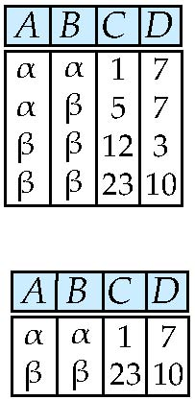
Select Operation – selection of rows (tuples)
Relation r
σ_{A=B ^ D > 5} (r)

Slide 32

Project Operation（投影运算）
Notation:
where A₁, A₂ are attribute names and r is a relation name.
The result is defined as the relation of k columns obtained by erasing（排除） the columns that are not listed
Duplicate（重复的）rows are removed from result, since relations are sets（集合）
Example: To eliminate the dept_name attribute of instructor ∏_{ID, name, salary} (instructor)
Notes:
关系是元组的集合，集合中的元素是不能重复的。
一元运算

Slide 33
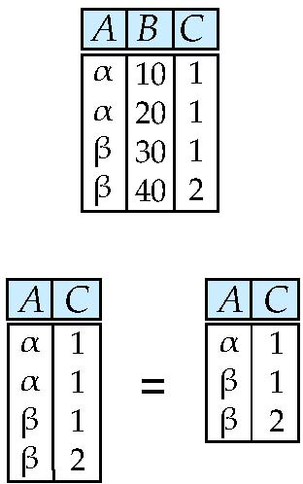
Project Operation – selection of columns (Attributes)
Relation r:
∏_{A,C} (r)

Slide 34



Union Operation（并运算）
Notation: r ∪ s
Defined as:
r ∪ s = {t | t ∈ r or t ∈ s}
For r ∪ s to be valid.
1. r, s must have the same arity（元） (same number of attributes 相同的属性个数)
2. The attribute domains must be compatible（相容的）
(example: 2nd column of r deals with the same type of values as does the 2nd column of s)
Example: to find all courses taught in the Fall 2009 semester, or in the Spring 2010 semester, or in both
∏_{course_id} (σ _{semester=“Fall” Λ year=2009} (section)) ∪ ∏_{course_id} (σ _{semester=“Spring” Λ year=2010} (section))
Notes:
集合取并集。
二元运算

Slide 35
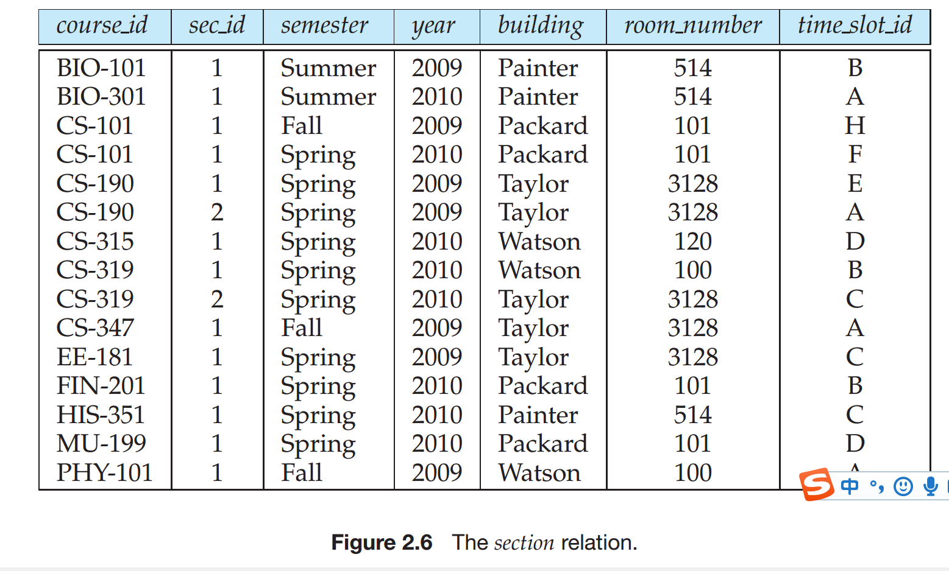
Union Operation（并运算）
Notes:
集合取并集。
二元运算

Slide 36
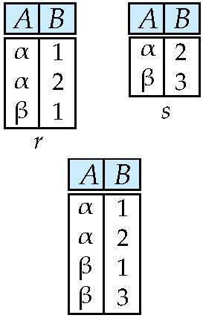
Union of two relations
Relations r, s:
r ∪ s:

Slide 37
Set Difference Operation（集合差运算）
Notation：r – s
Defined as:
r – s = {t | t ∈ r and t ∉ s}
Set differences must be taken between compatible relations.
r and s must have the same arity（元）
attribute domains of r and s must be compatible
Example: to find all courses taught in the Fall 2009 semester, but not in the Spring 2010 semester
∏_{course_id} (σ _{semester=“Fall” Λ year=2009} (section)) − ∏_{course_id} (σ _{semester=“Spring” Λ year=2010} (section))

Slide 38
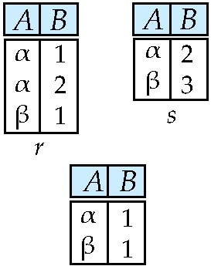
Set difference of two relations
Relations r, s:
r – s:

Slide 39
Set Intersection（集合交） Operation
Notation: r ∩ s
Defined as:
r ∩ s = { t | t ∈ r and t ∈ s }
Assume:
r, s have the same arity
attributes of r and s are compatible
Note: r ∩ s = r – (r – s)

Slide 40
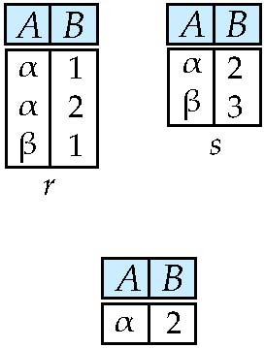
Set intersection of two relations
Relation r, s:
r ∩ s
Note: r ∩ s = r – (r – s)

Slide 41
Cartesian-Product Operation（笛卡尔积运算）
Notation：r x s
Defined as:
r x s = {t q | t ∈ r and q ∈ s}
Assume that attributes of r(R) and s(S) are disjoint（不相交的）. (That is, R ∩ S = ∅).
If attributes of r(R) and s(S) are not disjoint, then renaming must be used. （为了加以区分，通过表名前缀进行重命名）
Notes:
笛卡尔积：实现将任意两个关系的元组组合在一起，不管元组之间是否匹配，是两个关系所有元组的全排列组合。
结果集为一个新的大的关系，是两个关系的串接，将两张表连接在一张表中。
假设r中有n1个元组，m个属性；s中有n2个元组，n个属性，那么r x s中包含n1x n2个元组，m+n个属性。

Slide 42
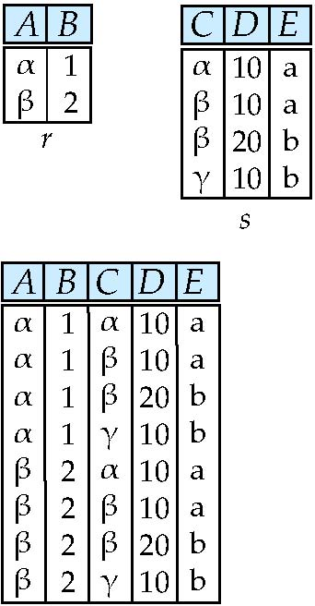
joining two relations -- Cartesian-product
Relations r, s:
r x s:

Slide 43
Cartesian-product – naming issue
Relations r, s:
B
r x s:
r.B
s.B

Slide 44
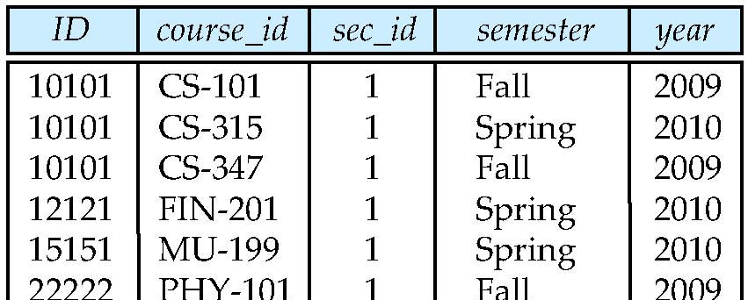
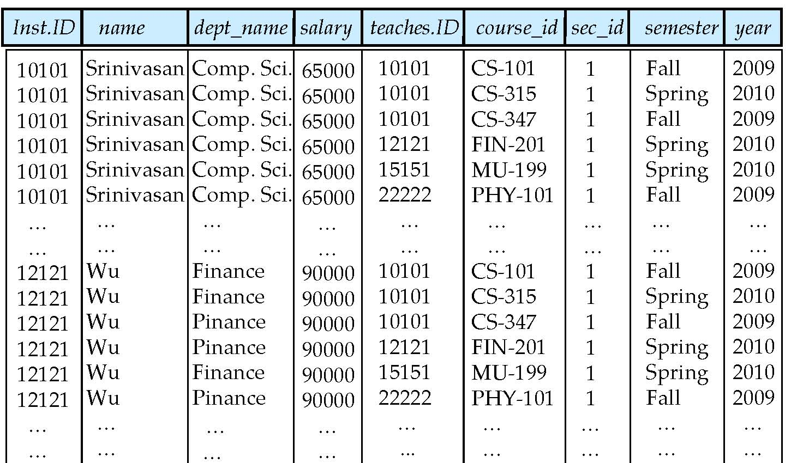
Cartesian Product
instructor
teaches

Slide 45
Joining two relations – Natural Join
Let r and s be relations on schemas R and S respectively. Then, the “natural join” of relations R and S is a relation on schema R ∪ S obtained as follows:
Consider each pair of tuples t_{r} from r and t_{s} from s.
If t_{r} and t_{s} have the same value on each of the attributes in R ∩ S, add a tuple t to the result, where
t has the same value as t_{r} on r
t has the same value as t_{s} on s

Slide 46

Natural Join（自然连接） Operation
Example:
R = (A, B, C, D)
S = (E, B, D)
Result schema = (A, B, C, D, E)
r s is defined as: ∏_{r.A, r.B, r.C, r.D, s.E} (σ_{r.B = s.B} ∧ _{r.D = s.D} (r x s))
注：自然连接运算首先形成它的两个参数的笛卡儿积，然后基于两个关系模式中都出现的属性上的相等性进行选择，最后还要去除重复属性。
Notes:
笛卡尔积查询：建立两个表间的关联。
有些情况下需要对笛卡尔积查询进行简化，需要对笛卡尔积结果进行选择运算。
自然连接：有选择的笛卡尔积。
举例：
查询所有选修了课程的同学信息和所选修的课程信息。
首先，分析涉及哪些数据表：S和SC；
然后，建立两个表间的关联，用笛卡尔积；
再次，选择Sno一致的元组，也就是根据两个表中都出现的属性上的相等性进行选择；
最后，去掉重复属性，并投影到所要查询的属性。
S(Sno, Sname)
C(Sno, Cno)
∏_{S.sno, S.sname, SC.cno} (σ_{S.sno =SC.sno} (S x SC))等价于S 自然连接 SC

Slide 47
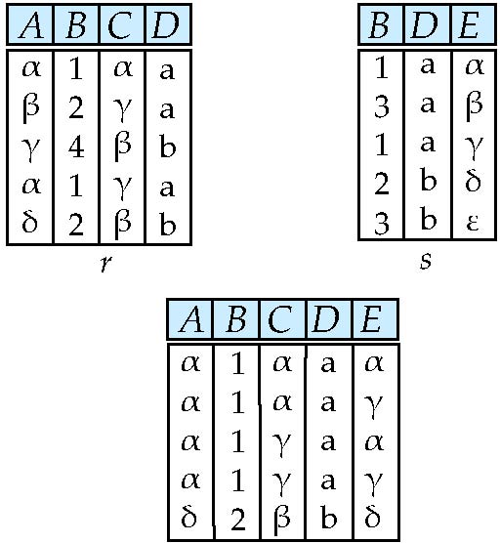
Natural Join Example
Relations r, s:
Natural Join
r s
∏ _{A, r.B, C, r.D, E} (σ _{r.B = s.B ˄ r.D = s.D} (r x s)))

Slide 48
Renaming a Table
Allows us to refer to a relation, (say E) by more than one name.
ρ _{x} (E)
returns the expression E under the name X
Relations r
r.A r.B s.A s.B
r x ρ _{s} (r)
α
α
β
β
1
1
2
2
α
β
α
β
1
2
1
2
Notes:
重命名：建立自连接时通常被用到。涉及到相同属性的值的比较时通常会用到自连接。
例如：查询和班长住在同一个宿舍的学生学号和姓名。

Slide 49
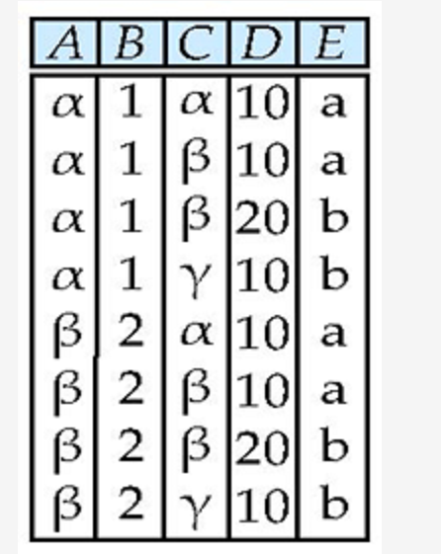
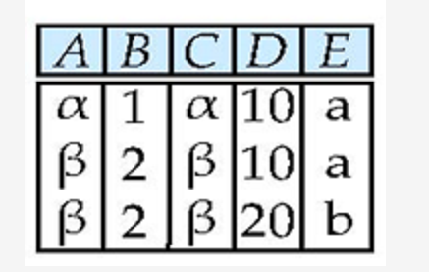

Composition of Operations
Can build expressions using multiple operations
Example: σ_{A=C} (r x s)
r x s
σ_{A=C} (r x s)

Slide 50
Composition of Operations
1.查询计算机系所有教师的名字：
2.查询所有教师的姓名，连同他们教的所有课程的course_id
3. 查询计算机系的所有教师，以及他们教授的所有课程的名称

Slide 51

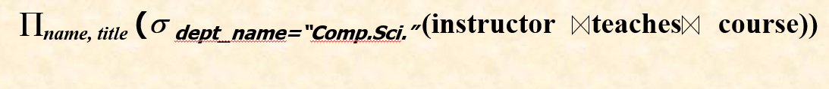
Composition of Operations
查询计算机系所有教师的名字：
∏_{name} (σ _{dept=“Comp.Sci.”} ( instructor))
查询所有教师的姓名，连同他们教的所有课程的course_id
查询计算机系的所有教师，以及他们教授的所有课程的名称

